Slide 1
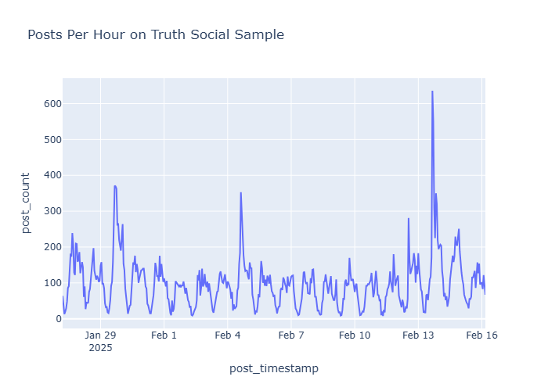
For your Streamlit dashboard, the top of the dashboard should have some file upload button and then the option to “map” columns that the program will analyze. I believe the columns that must be mapped are “unique userID”, “post content”, “timestamp”, and “unique post number”. We will not need this functionality when we integrate the dashboard into our app (since we have our own) - but it will be essential when we are testing your dashboard ourselves, so we can upload our own data.
Burst Detection Test
Click on a shaded burst to view which accounts contributed to the instance

Slide 2
For your Streamlit dashboard, the top of the dashboard should have some file upload button and then the option to “map” columns that the program will analyze. I believe the columns that must be mapped are “unique userID”, “post content”, “timestamp”, and “unique post number”. We will not need this functionality when we integrate the dashboard into our app (since we have our own) - but it will be essential when we are testing your dashboard ourselves, so we can upload our own data.
Burst Detection Test
Return to default
Burst Period: 1/29/2025 6:00 - 1/29/2025 20:00
Total posts: 350
Key burst contributors:
10
20
1 frazzledjazz
5% of all posts
2 monkeymix
4% of all posts
3 joneser
…
These bars could keep going for the top 50 accounts?
3.5% of all posts
Notes:
THIS IS WHAT YOU SEE IF YOU CLICK ON A BURST IN THE GRAPH

Slide 3
For your Streamlit dashboard, the top of the dashboard should have some file upload button and then the option to “map” columns that the program will analyze. I believe the columns that must be mapped are “unique userID”, “post content”, “timestamp”, and “unique post number”. We will not need this functionality when we integrate the dashboard into our app (since we have our own) - but it will be essential when we are testing your dashboard ourselves, so we can upload our own data.
Burst Detection Test
Return to default
Burst Period: 1/29/2025 6:00 - 1/29/2025 20:00
Total posts: 350
Return to contributor list
Selected account: frazzledjazz
Total posts: 19 (5% of total)
 | Post Content | Unique Post Number | Timestamp
1 | Call for rebellion! It’s that time | 0139395 | 1/29/2025 06:24
2 | I say we revolt - let’s do it! | 2023525 | 1/29/2025 06:31
3 | Can you hear the bells fernando? | 2595252 | 1/29/2025 06:45
4 | Ring the bells - we rise up now! | 3528821 | 1/29/2025 06:56
5 | Nothing can stop us now! | 2352522 | 1/29/2025 07:01
Notes:
THIS IS WHAT YOU SEE IF YOU CLICK ON OF THE ACCOUNTS LISTED UNDER “KEY BURST CONTRIBUTORS”

